Slide 1


Trực quan hóa dữ liệu bằng
ngôn ngữ lập trình R
TS. Lưu Phúc Lợi,
Trưởng Phòng Nghiên cứu khoa học, Viện Ariha
Bệnh viện Thống Nhất
Jan 11, 2026

Slide 2
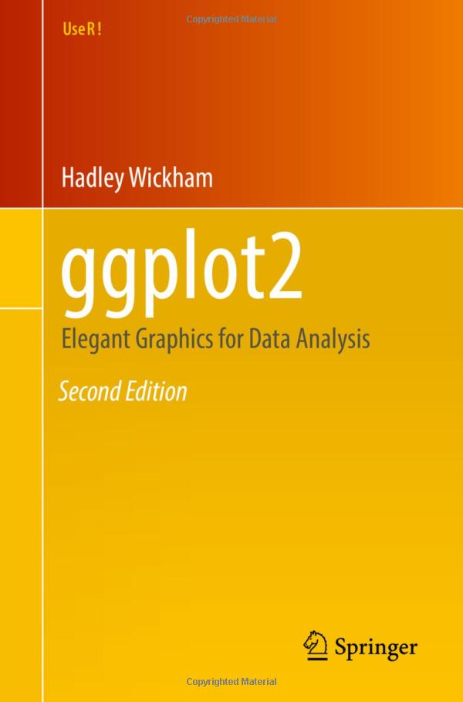

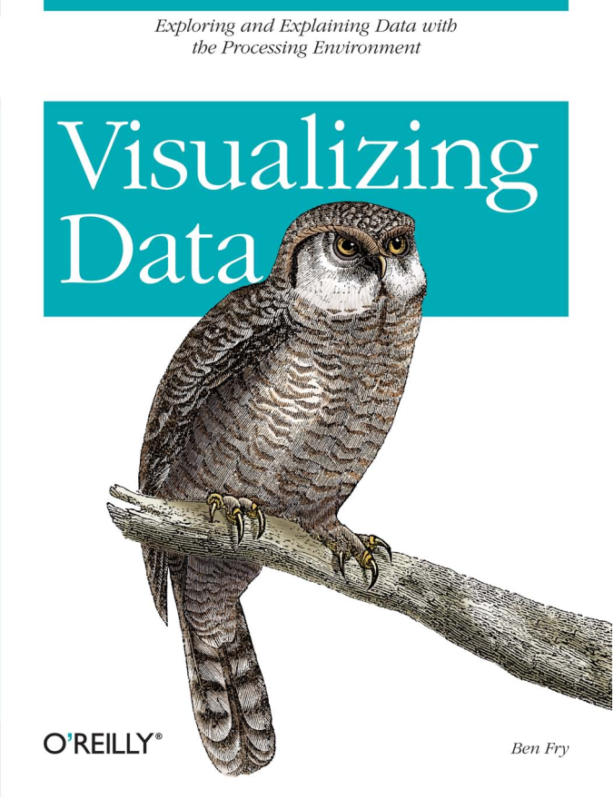
Books, slides, exercises and solutions to exercises
https://www.iaacblog.com/programs/books-about-data-visualization/
(VD)
https://ggplot2-book.org/index.html
(GGP)
https://link.springer.com/book/10.1007/978-3-540-33037-0
(HDV)

Slide 3
Roadmap of today lecture
Overview of basic plots
Types of plots
Visualizing Images in pathology
Why Do We Visualize Data?
Student Projects

Slide 4
Basic Plots
Survival plot
Volcano and MA plot
Scatter plot
Dot plot
Time series plot
Spatial/ Map/Location plot
Hexabin/contour plot
ROC curve
RMSE
Circos plot
Hexanbin plot
Maths plot
Radar plot
Table
Bar/pie/waterfall plot
Boxplot
Histogram/density/violin
Variant of boxplot/histogram/density/violin/cloud
Parallel plot and its variants
Heatmap
Dendrogram
Venn diagram
Upset plot
Forest plot

Slide 5
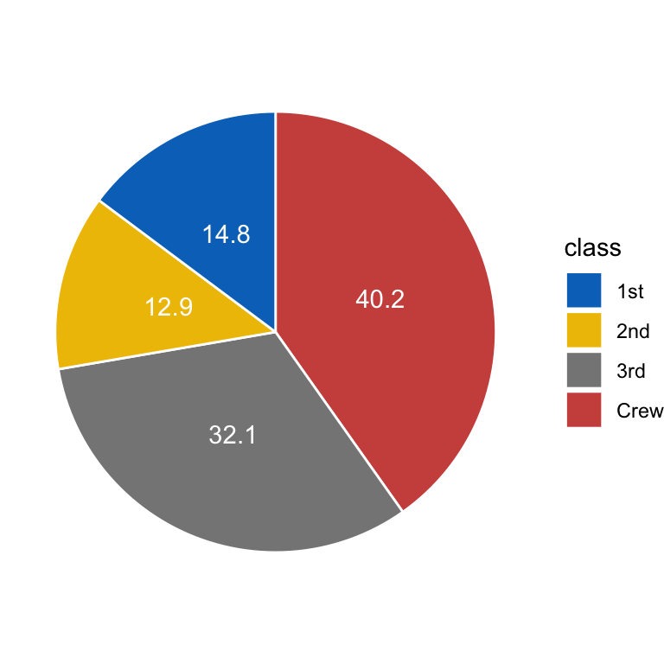
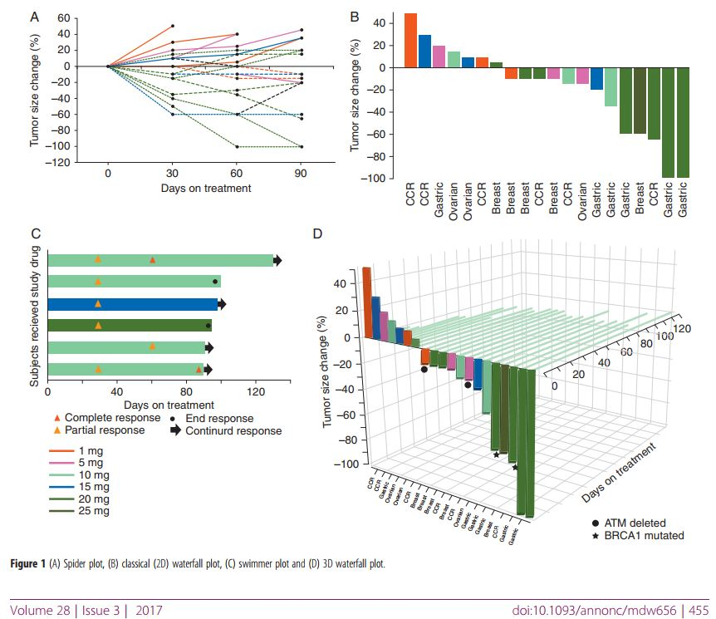
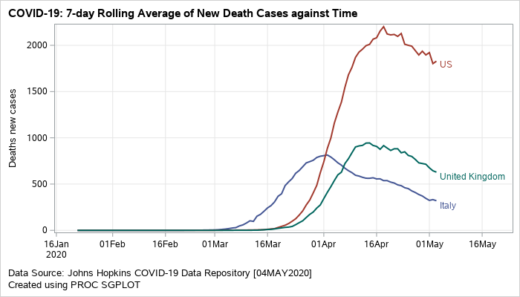
Pie + Bar + Water Fall + Time plot
10.1093/annonc/mdw656

Slide 6
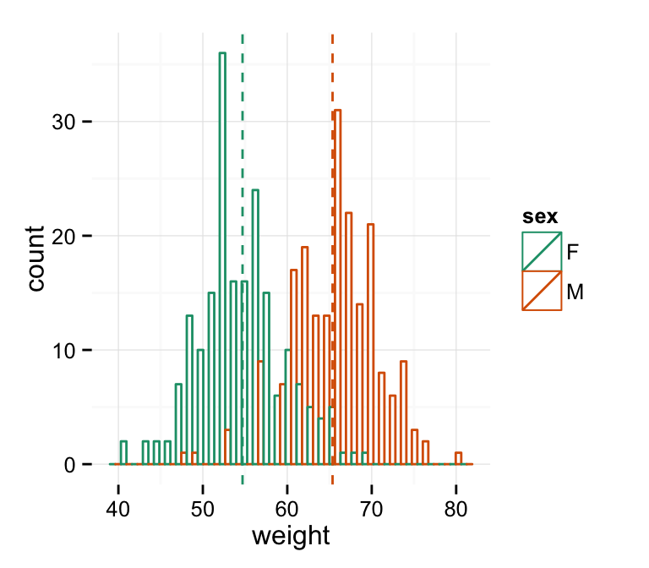
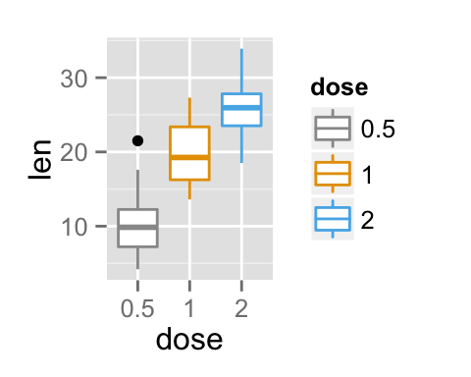
Boxplot and Histogram
10.1093/annonc/mdw656

Slide 7
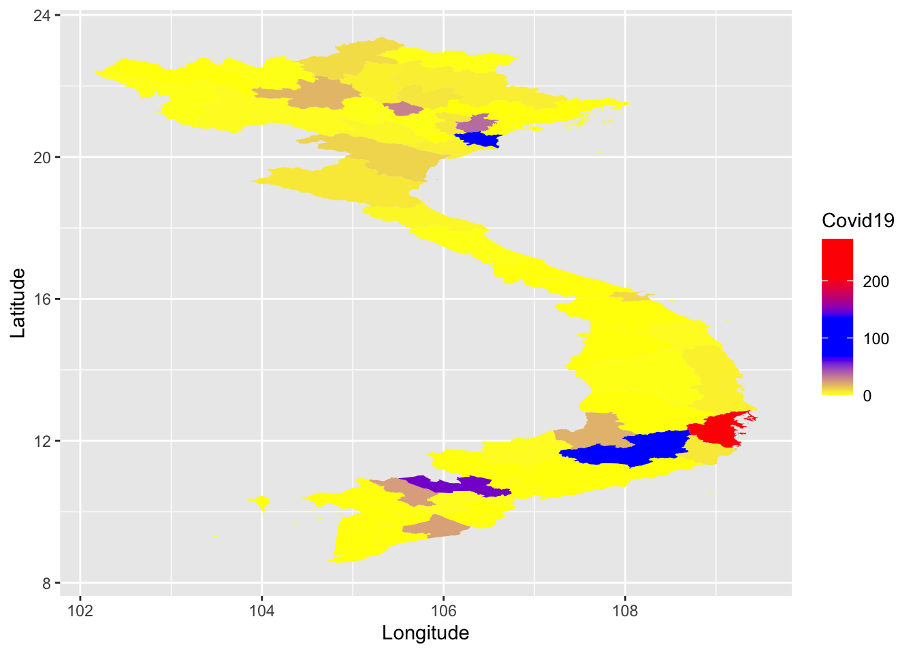
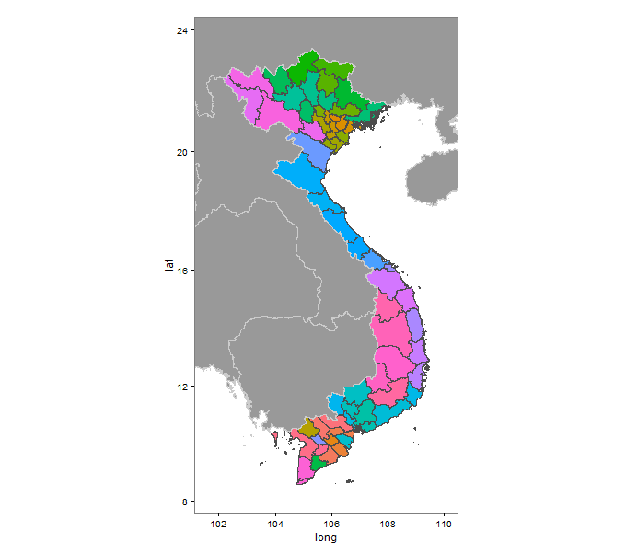
Map and location plots
https://rpubs.com/nguyet/647153
https://stackoverflow.com/questions/26914616/r-how-to-add-border-countries-to-a-country-spatialpolygons-map

Slide 8
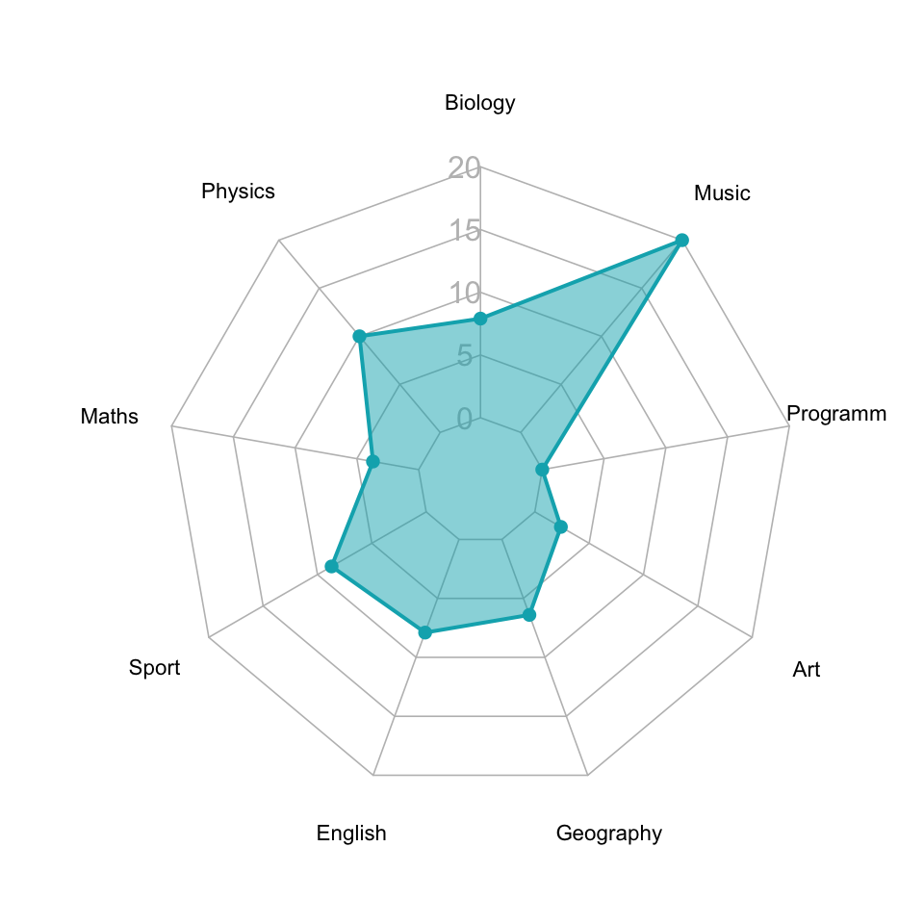
Radar plot
https://www.datanovia.com/en/blog/beautiful-radar-chart-in-r-using-fmsb-and-ggplot-packages/

Slide 9
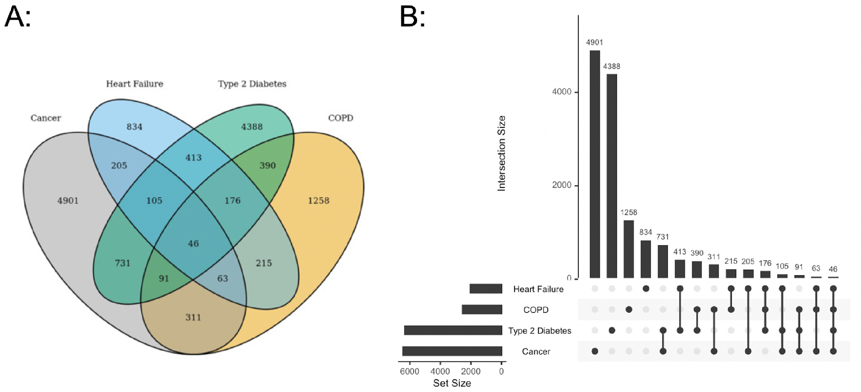
Ven Diagram and Upset plot
https://www.jpsmjournal.com/article/S0885-3924(22)01010-7/fulltext

Slide 10
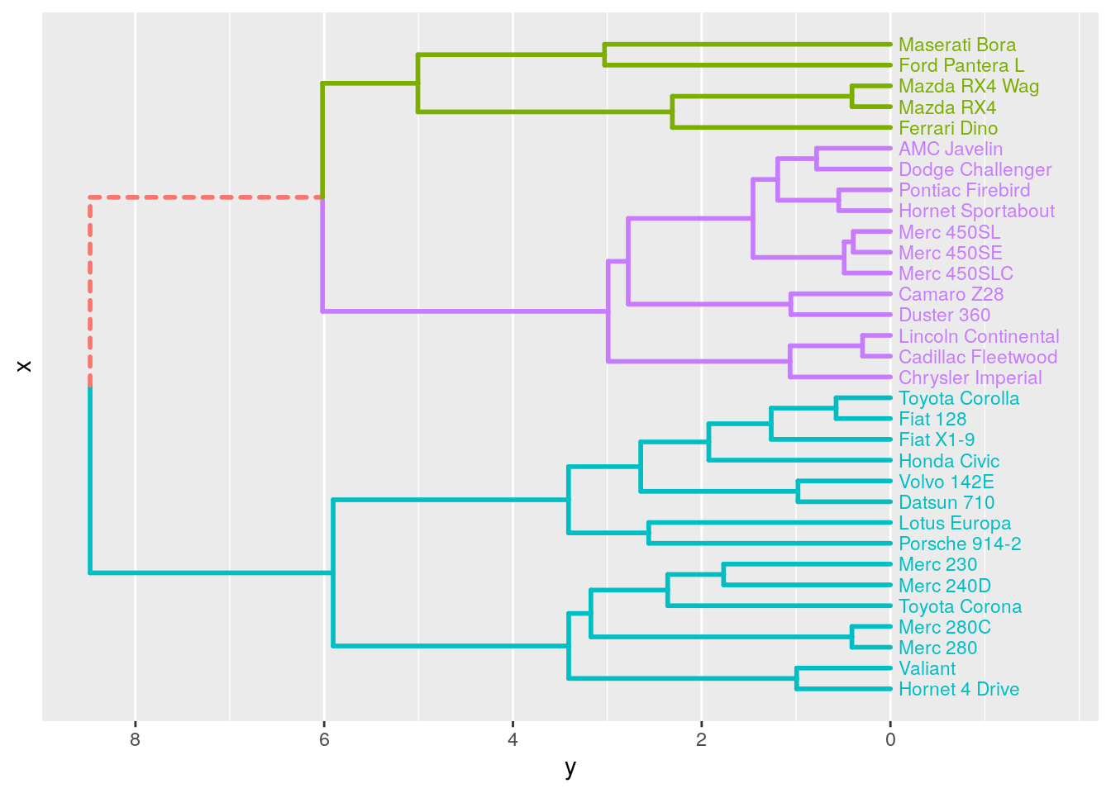
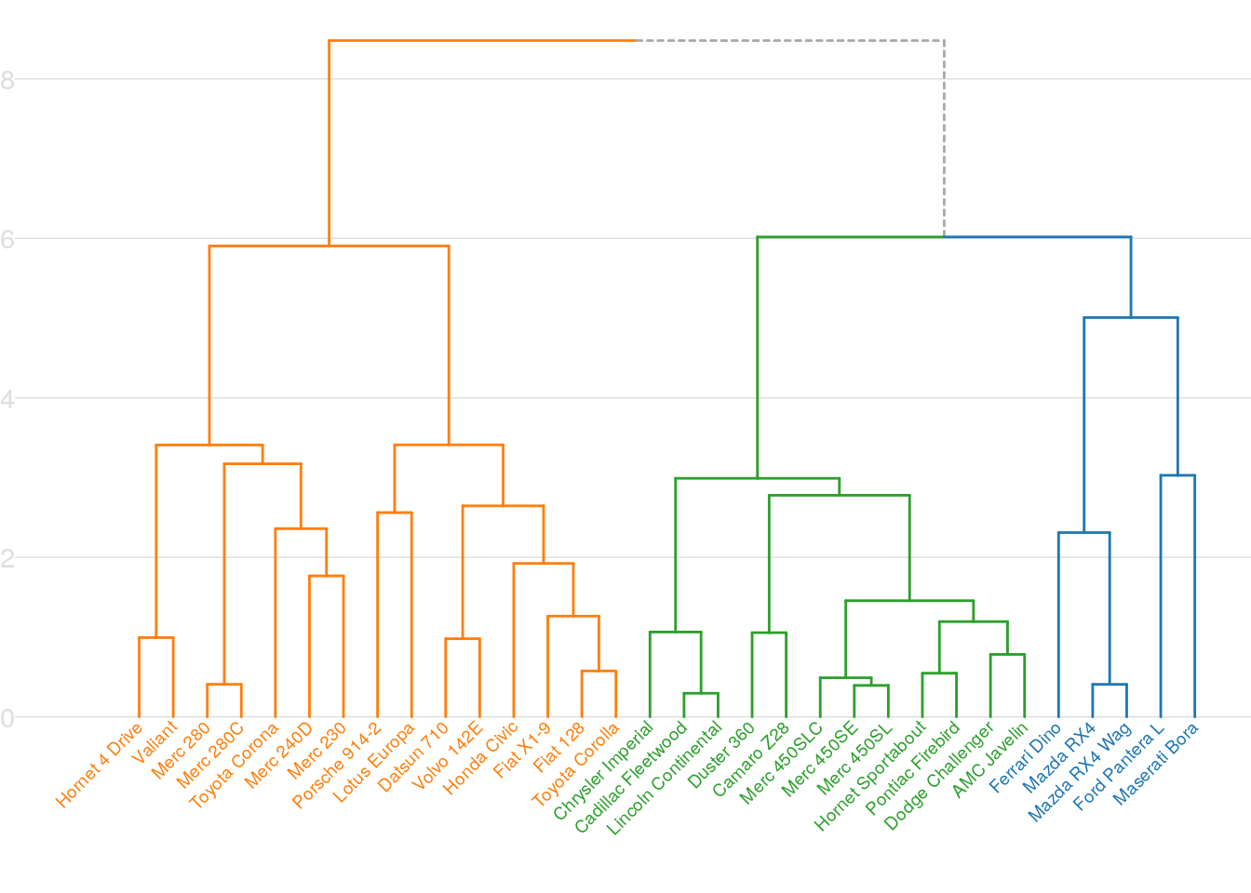
Dendrogram
https://atrebas.github.io/post/2019-06-08-lightweight-dendrograms/

Slide 11
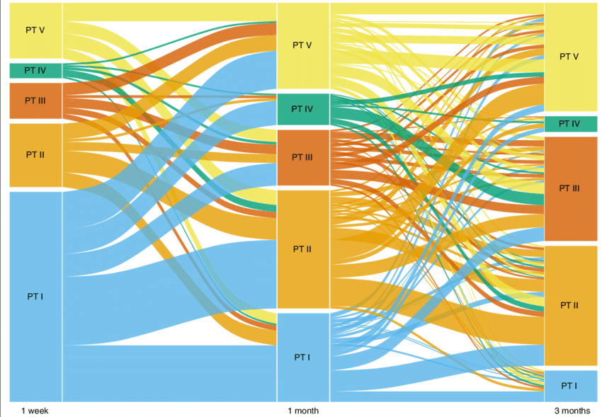
Alluvial Plot
https://microbiomejournal.biomedcentral.com/articles/10.1186/s40168-016-0215-9

Slide 12
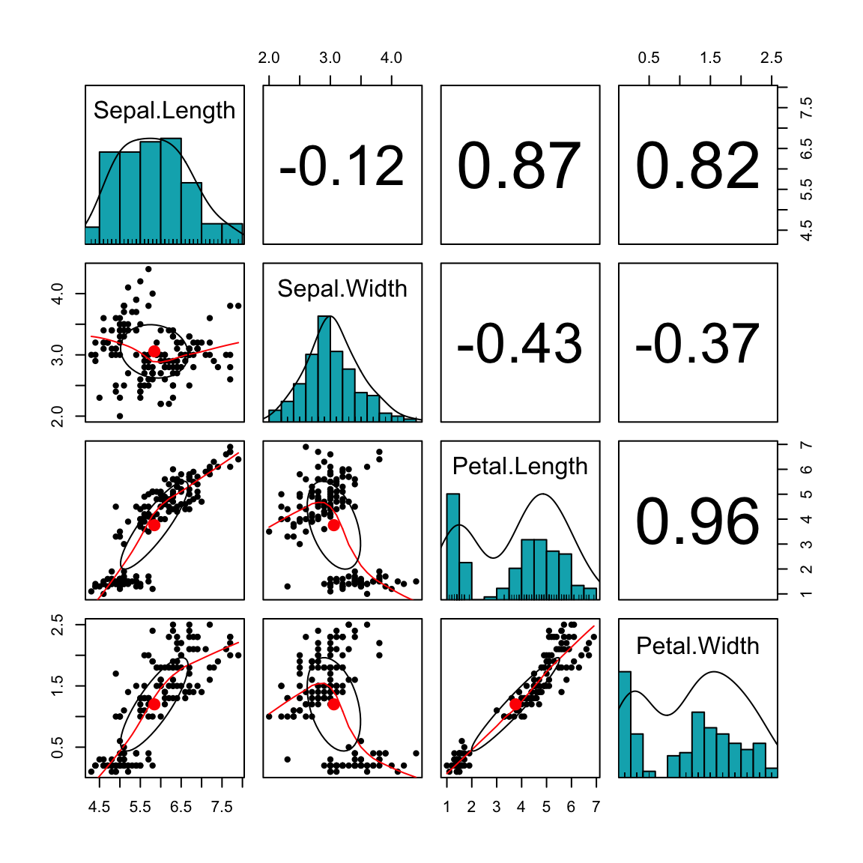
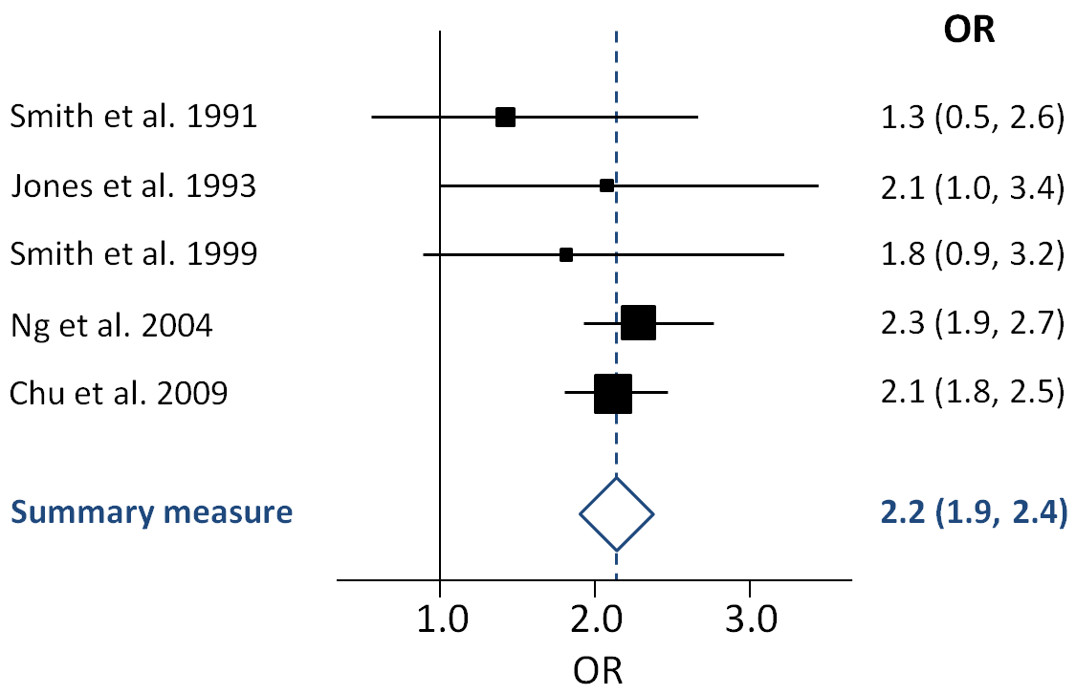
Forest plot vs matrix plot
https://en.wikipedia.org/wiki/Forest_plot
http://www.sthda.com/english/wiki/scatter-plot-matrices-r-base-graphs

Slide 13
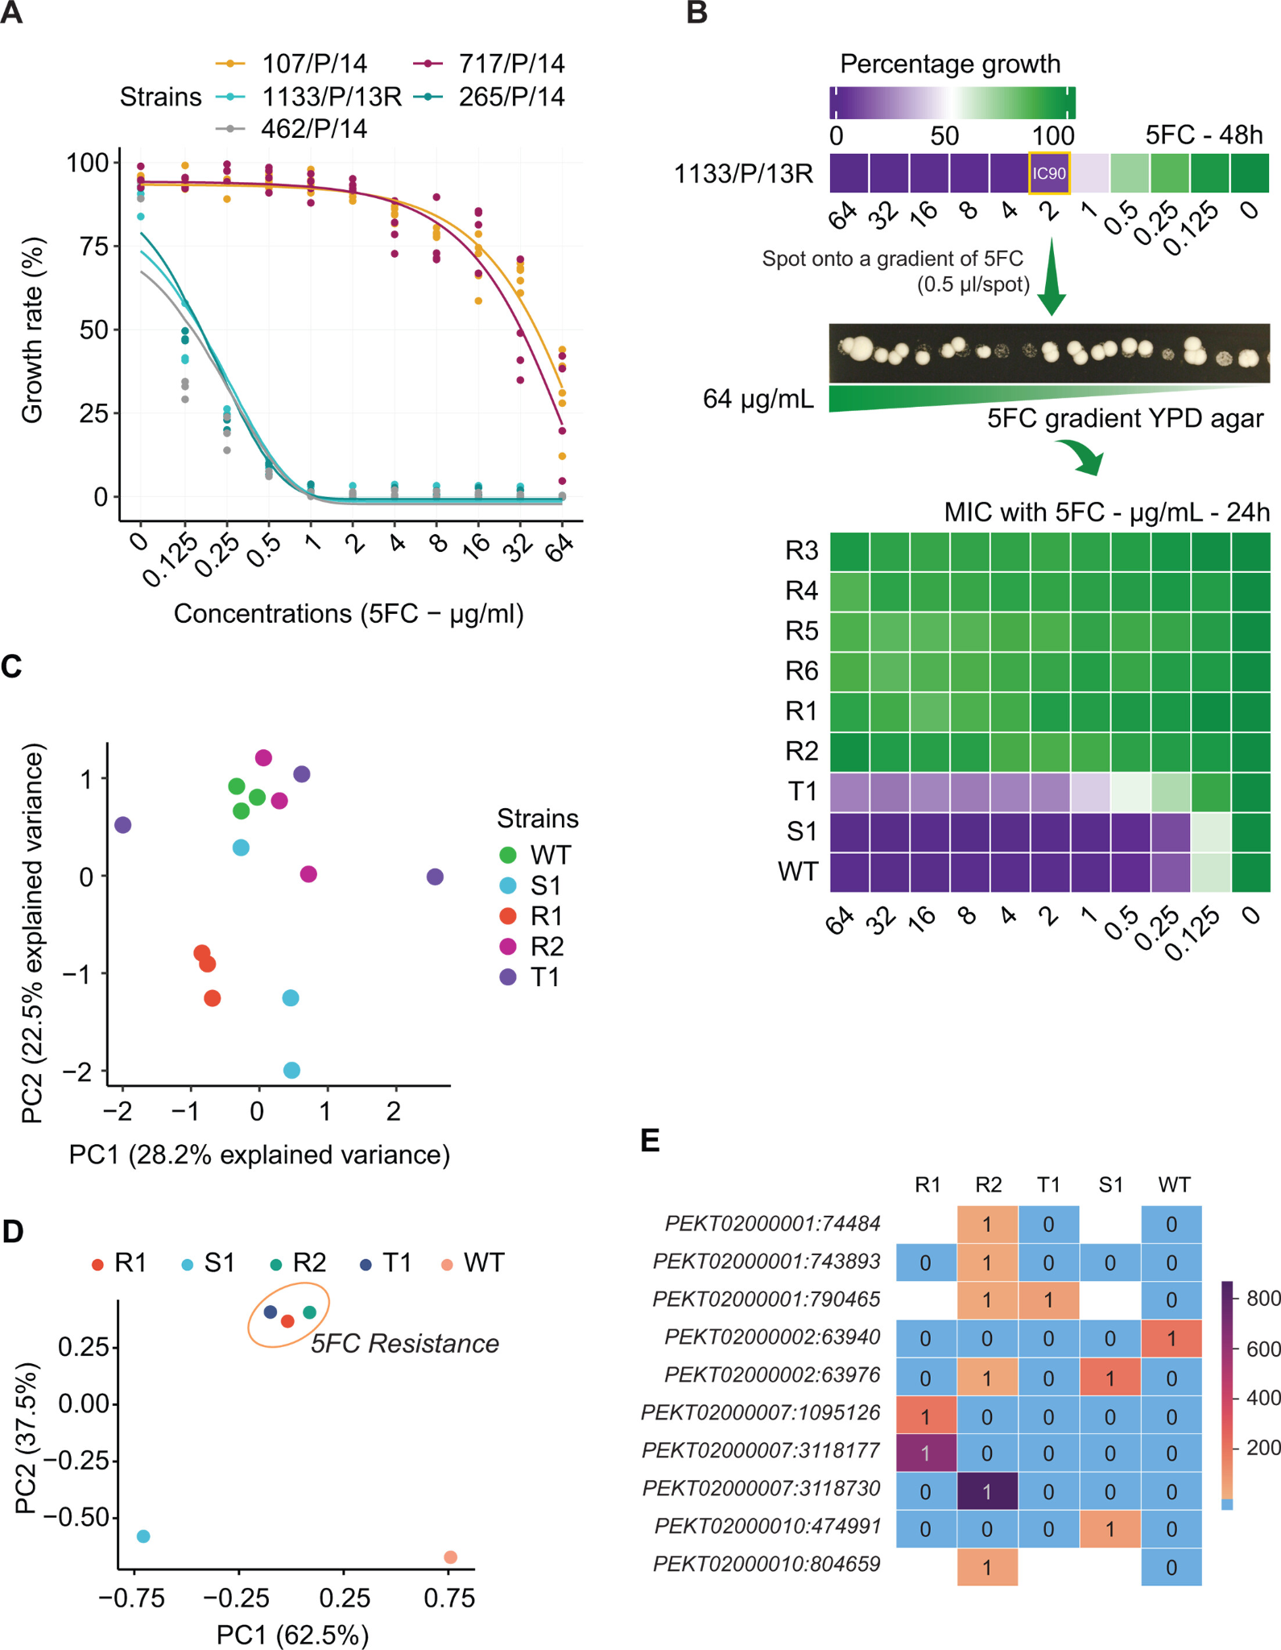
In vitro evolution of 5FC resistance in C. auris
Notes:
(A) Dose response assays for 5FC with different C. auris clinical isolates. The lines represented predicted fitting curves using a four-parameter model from the drc R package. (B) Rapid evolution of 5FC resistance in MDR C. auris strains. (C) Principal component analysis (PCA) of 5FC-resistant and 5FC-sensitive clones based on gene expression data. 1133/P/13R–wild-type strain (WT); R1-R6: in vitro adapted 5FC-resistant clones; T1: clone showing 5FC tolerance; S1: 5FC-sensitive clone. (D) PCA for single nucleotide polymorphisms (SNPs) passing specific filtering criteria. (E) Comparative SNP profiling of C. auris strains against the susceptible wild type control (WT) strain; 1: refers to genotype-matching alternate allele compared to reference genome; 0: genotype is the same as the reference allele in the C. auris B8441 strain. Empty white spaces illustrate missing or unidentified genotypes in corresponding samples. The color bar on the right shows the number of alternate-supporting reads covered for a specific variant. At least three biological replicates were performed for MIC quantification and RNA-seq experiments.

Slide 14
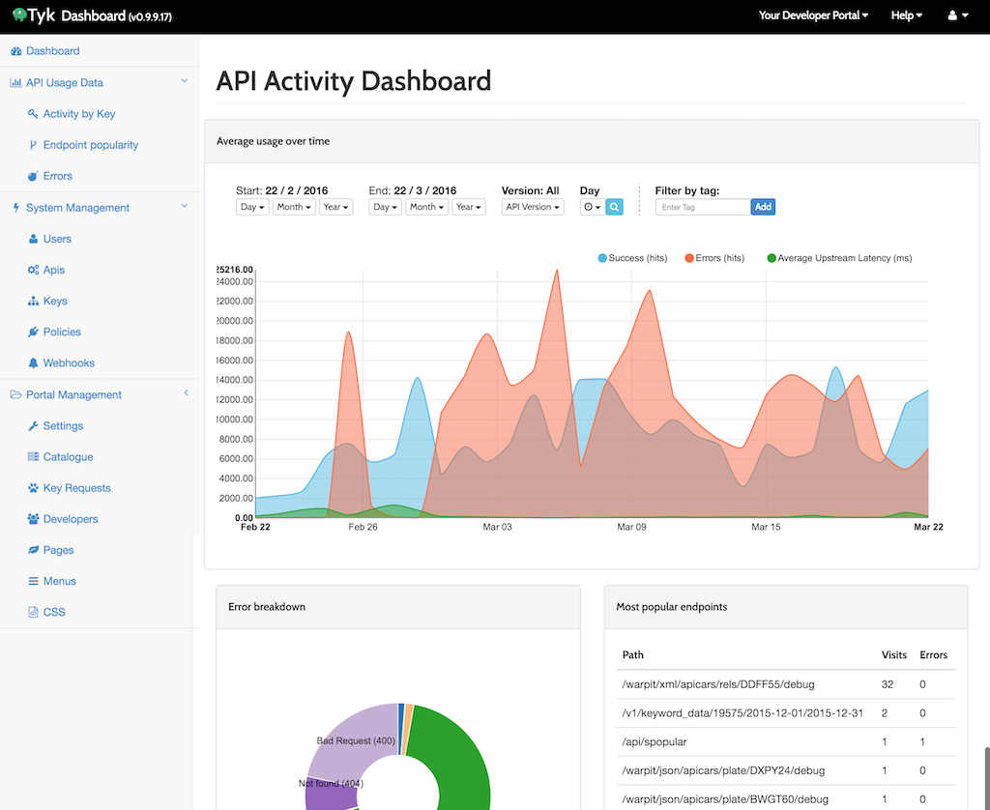
Dashboard with Tyk/Tableau
https://www.youtube.com/watch?v=BmInbeEkDPs&list=PLjCJtqjjSdAf9_xJzdaakpGKGBO8rGs-c&index=9

Slide 15
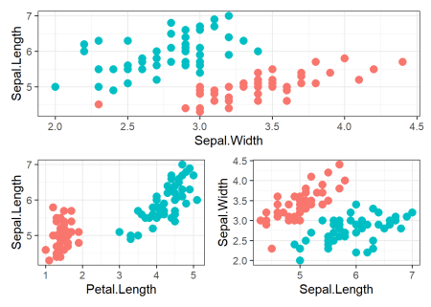
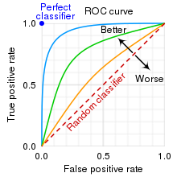
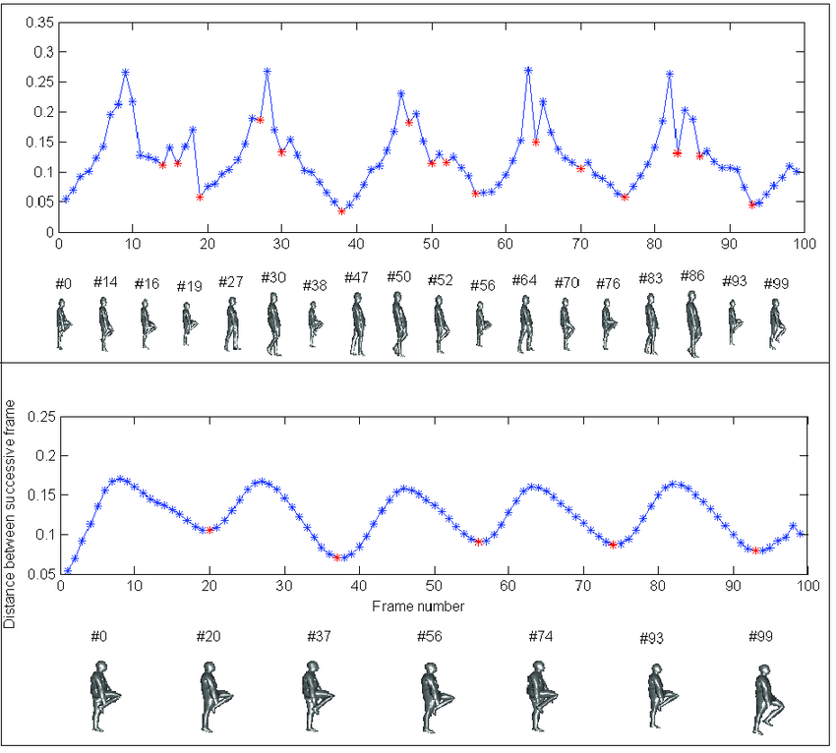
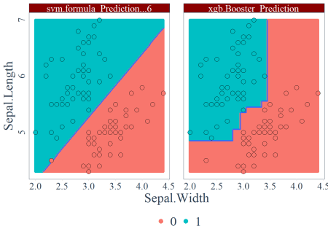
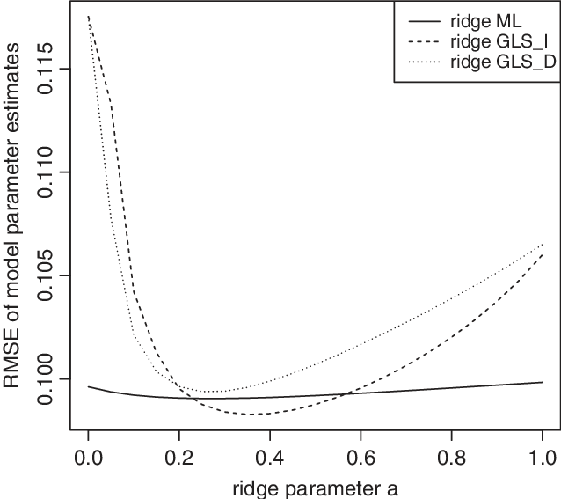
Data visualization for machine learning
Speed curve smoothing: (top) speed curve before smoothing, (bottom) speed curve after smoothing.
https://hal.archives-ouvertes.fr/tel-01094740/file/RimSlamaThesis2014.pdf
10.1080/10705511.2015.1077335

Slide 16
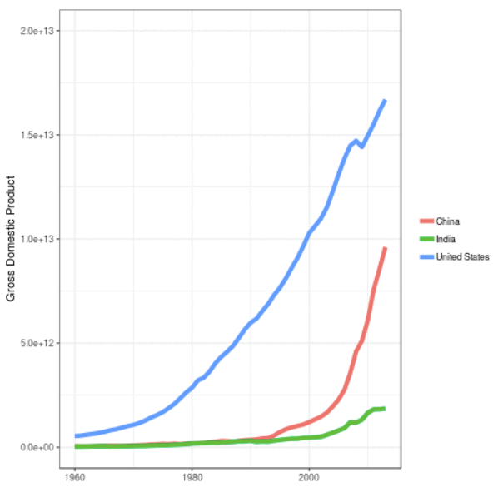
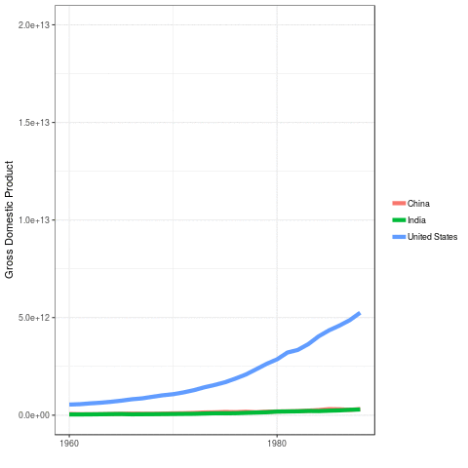
Amination plot
https://www.datanovia.com/en/blog/gganimate-how-to-create-plots-with-beautiful-animation-in-r/

Slide 17
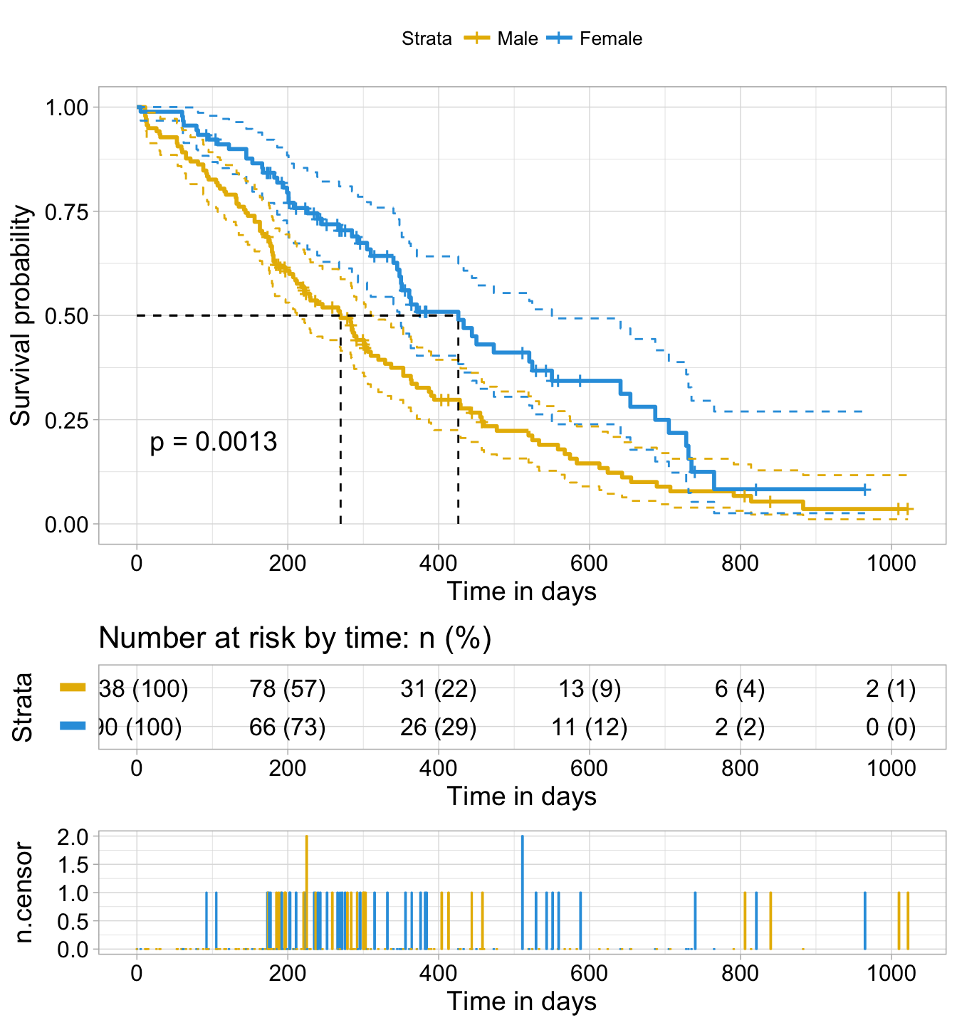
Survival plot (Kaplan-Meier Curve)
http://www.sthda.com/english/wiki/survival-analysis-basics

Slide 18
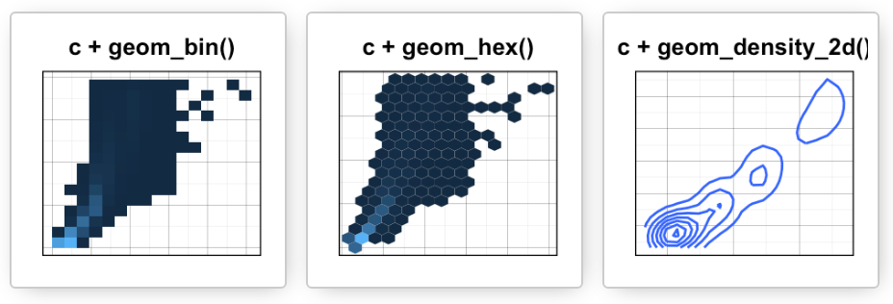
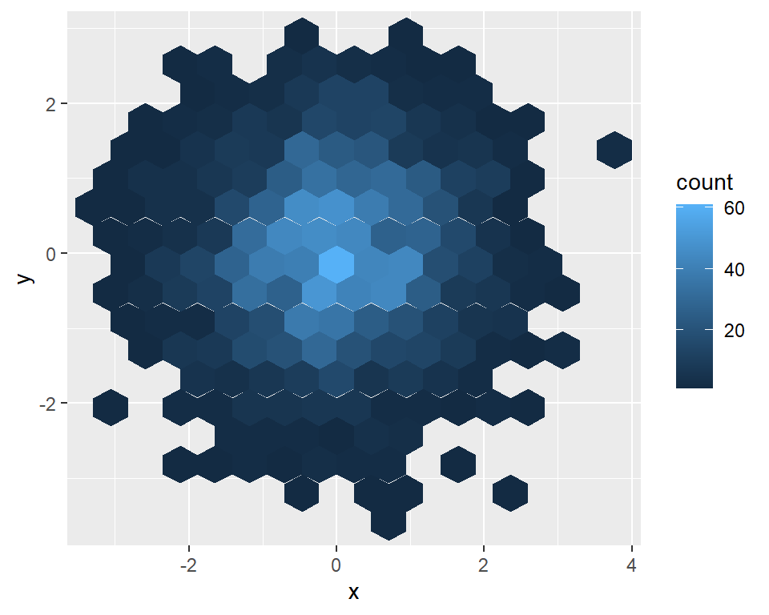
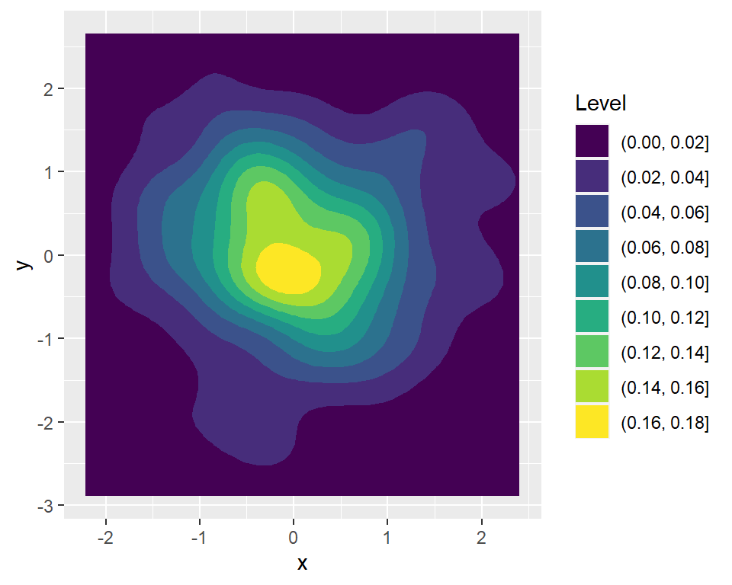
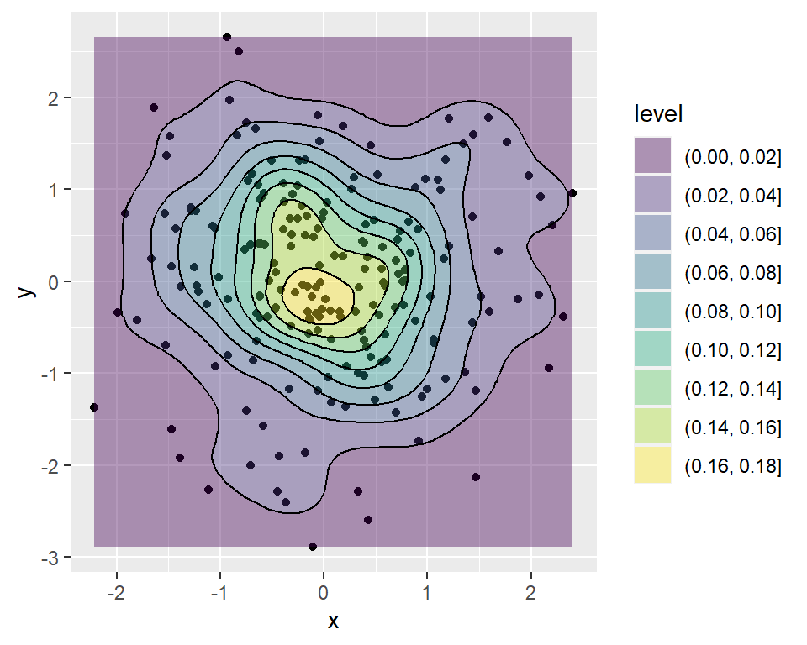
Binning and contour plot
https://r-charts.com/correlation/contour-plot-ggplot2/
https://vincenzocoia.com/post/contour_plots/
https://r-charts.com/correlation/hexbin-chart-ggplot2/

Slide 19
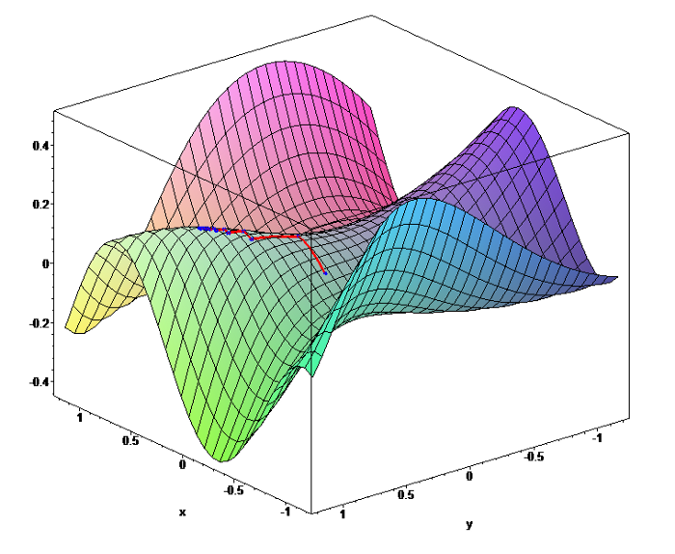
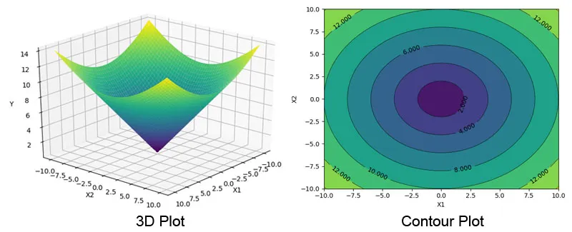
3D contour plot for Gradient Descent
https://medium.com/@jackyfeng530/machine-learning-gradient-descent-8681c40d27c3
http://www.adeveloperdiary.com/data-science/how-to-visualize-gradient-descent-using-contour-plot-in-python/

Slide 20
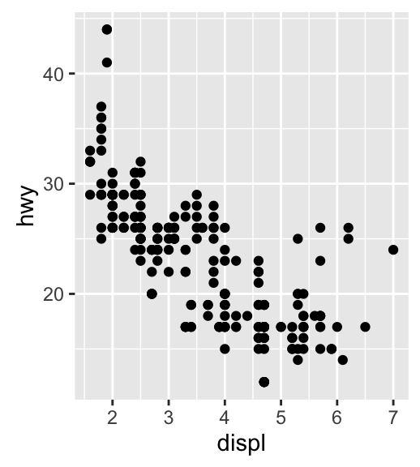
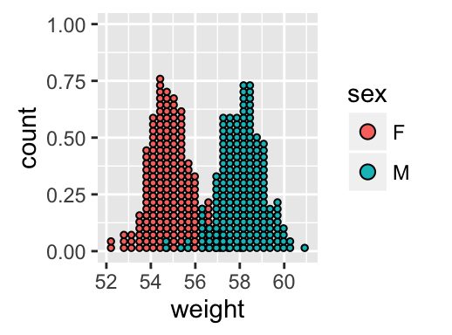
Dotplot and jitter plot

Slide 21
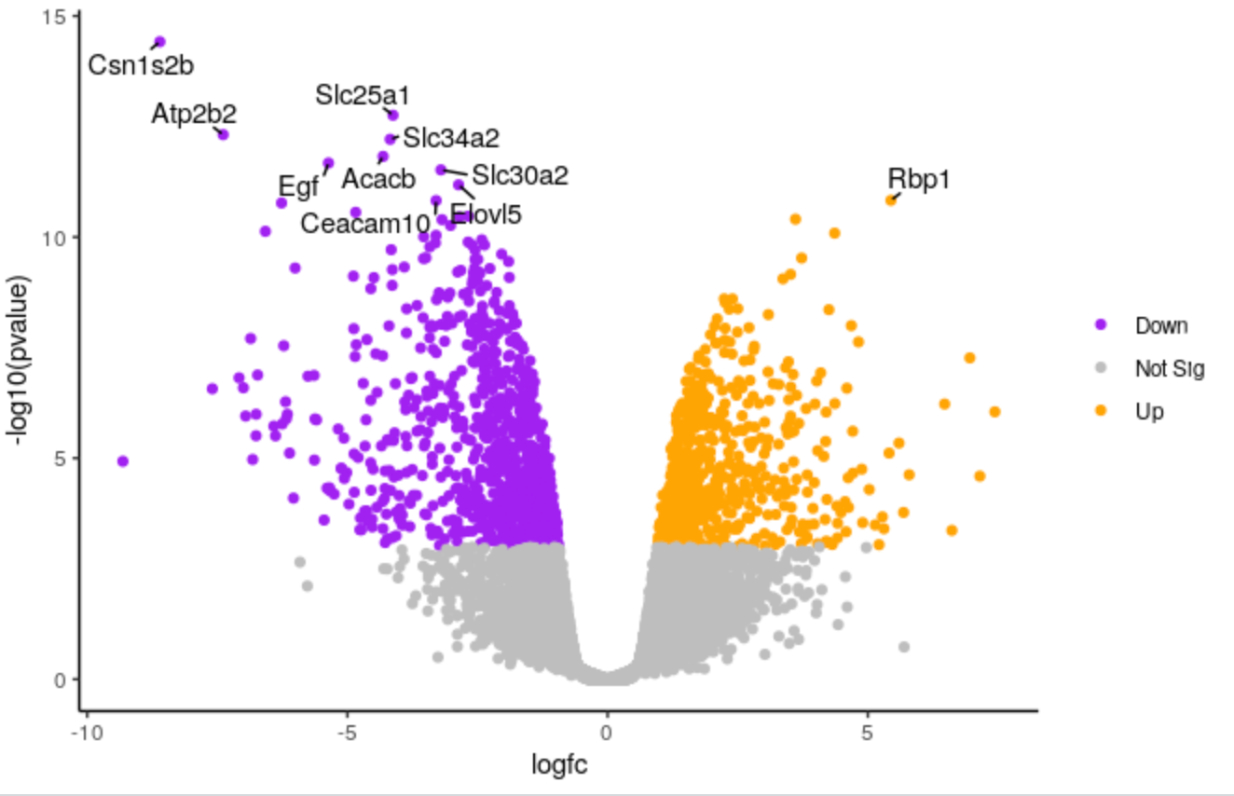
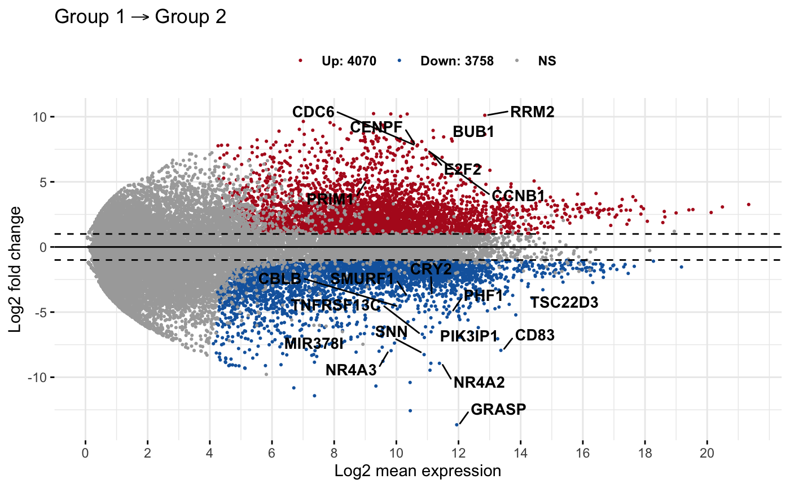
Volcano vs MA (Bland–Altman) plot
http://onetipperday.sterding.com/2012/11/t-test-volcano-plot.html
https://biocorecrg.github.io/CRG_RIntroduction/volcano-plots.html
https://rpkgs.datanovia.com/ggpubr/reference/ggmaplot.html

Slide 22
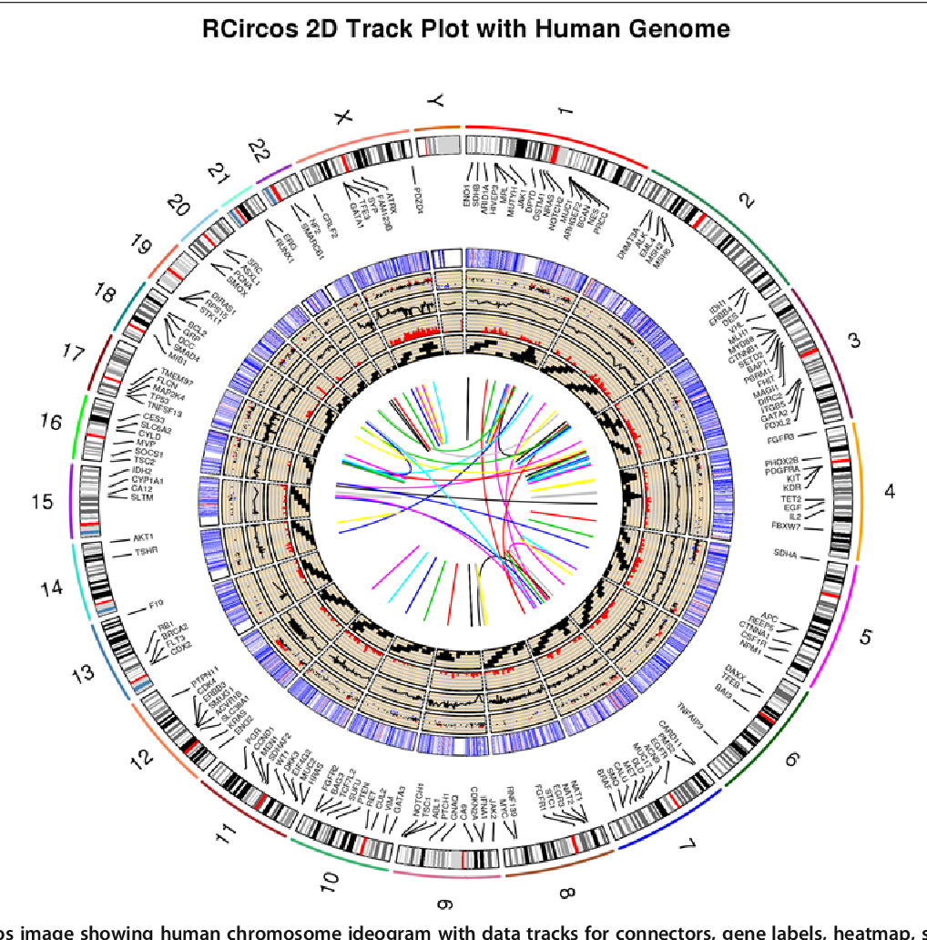
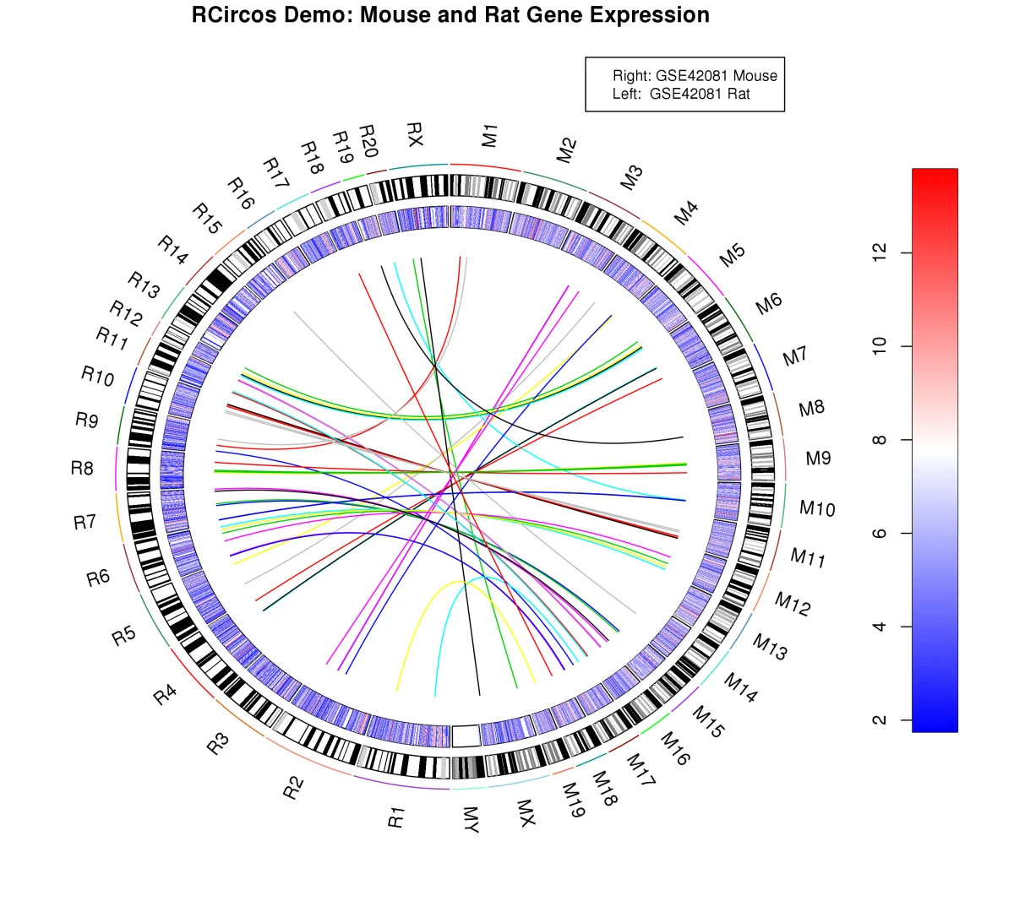
Circos plot
https://bmcbioinformatics.biomedcentral.com/articles/10.1186/1471-2105-14-244

Slide 23
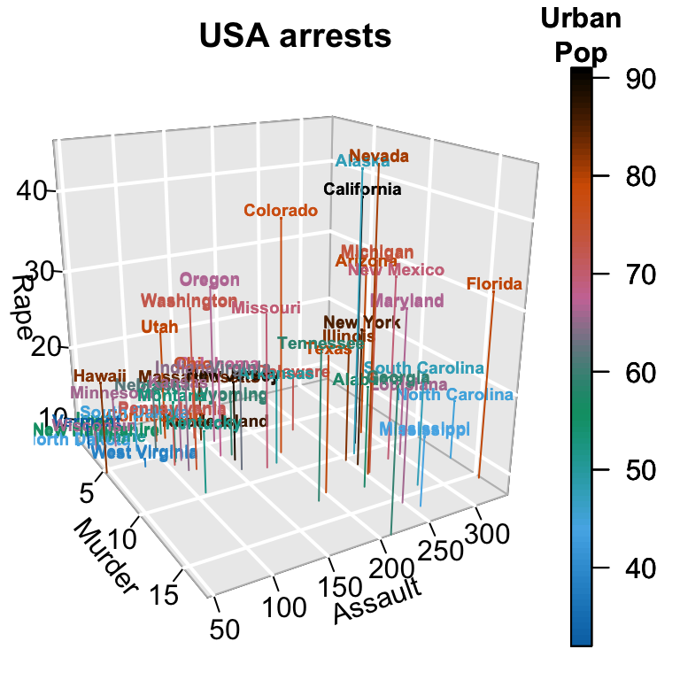
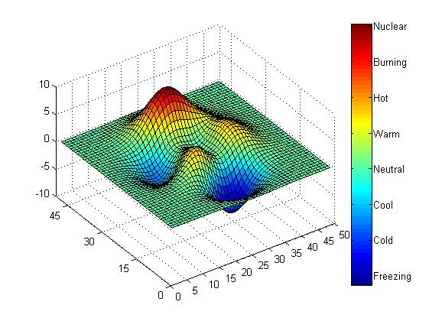
3D plot
http://www.sthda.com/english/wiki/impressive-package-for-3d-and-4d-graph-r-software-and-data-visualization
https://stackoverflow.com/questions/43330727/how-to-plot-three-dimension-data-or-four-dimension-data-to-filled-contour-plot-o

Slide 24
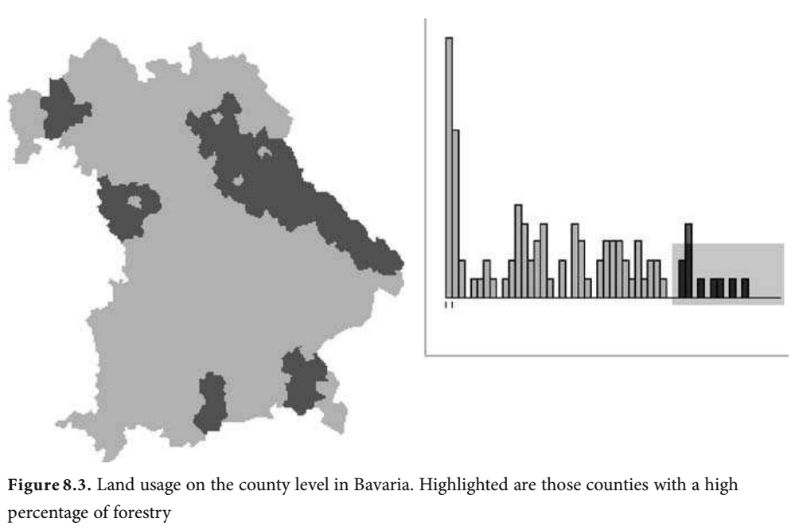
Linked Views for Visual Exploration

Slide 25
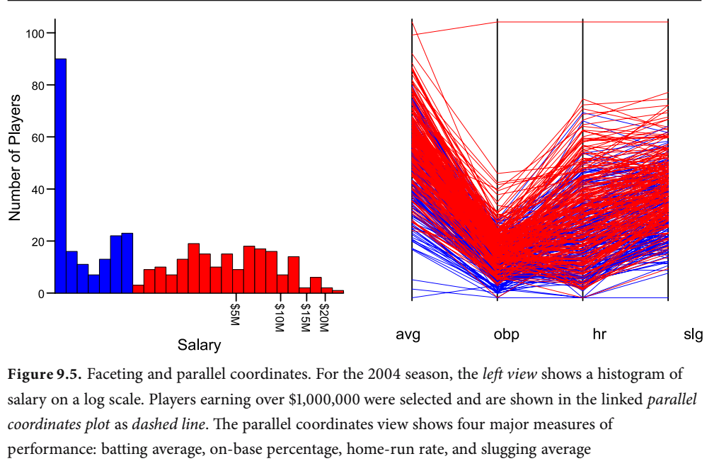
Linked Views for Visual Exploration

Slide 26
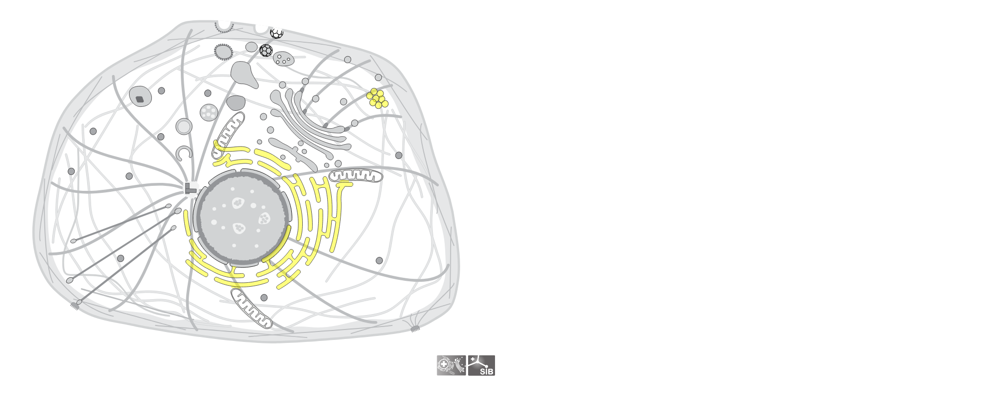
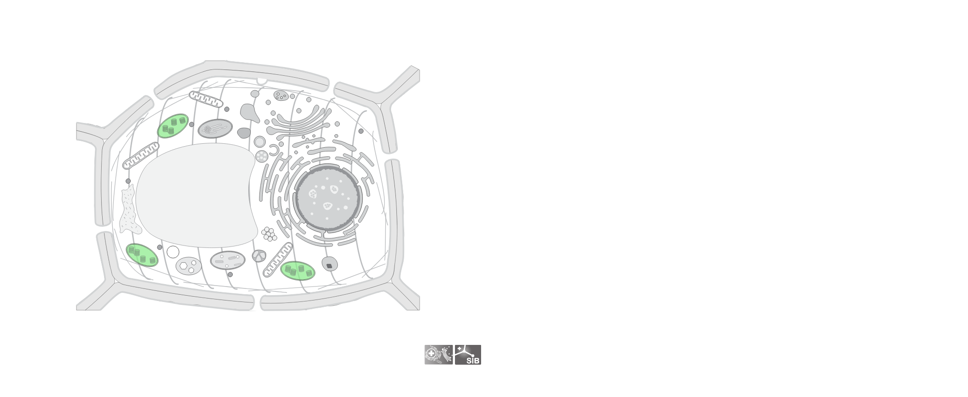

Draw Cell
https://github.com/svalvaro/drawCell

Slide 27
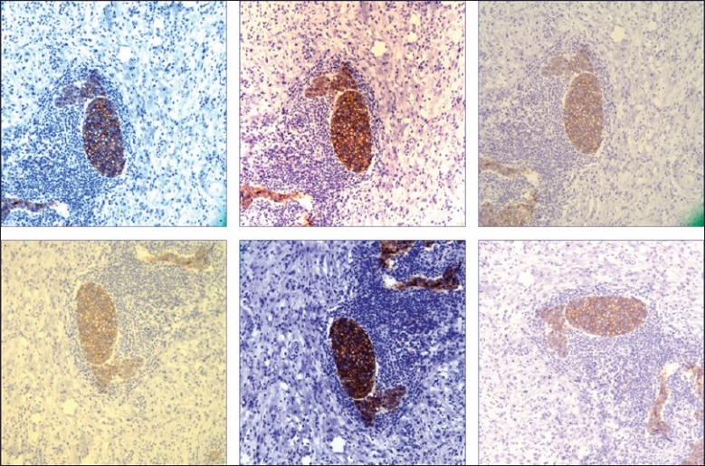
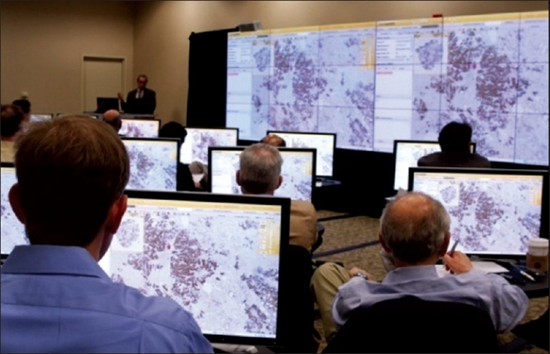
Visualizing Images in pathology
Different digital images of the same region on a glass slide photographed at the same magnification by six different pathologists, each using similar microscopes and the same attached digital cameras (HER-2/neu immunohistochemical stain)
Whole slide images help create a “virtual multiheaded microscope” that supports interactive education (Image courtesy of BioImagene)
https://www.ncbi.nlm.nih.gov/pmc/articles/PMC2941968/

Slide 28
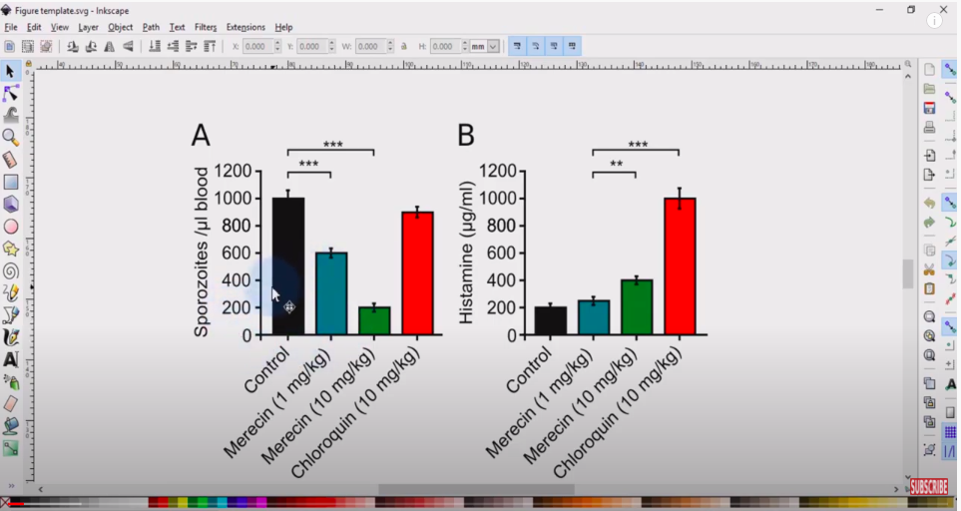
Inkscape for scientists: Making a data figure for a publication

Slide 29
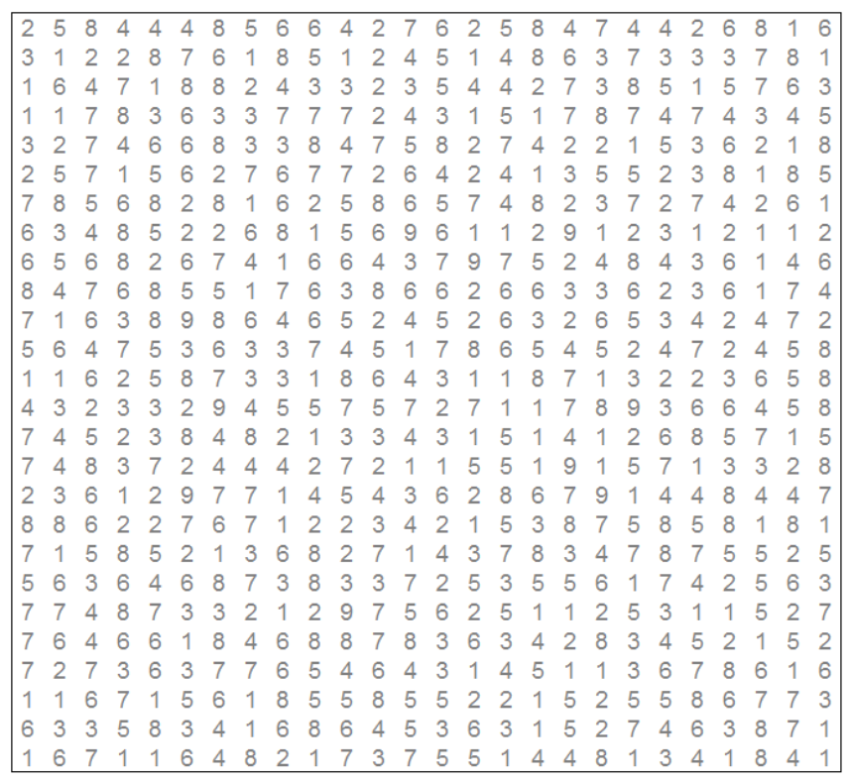
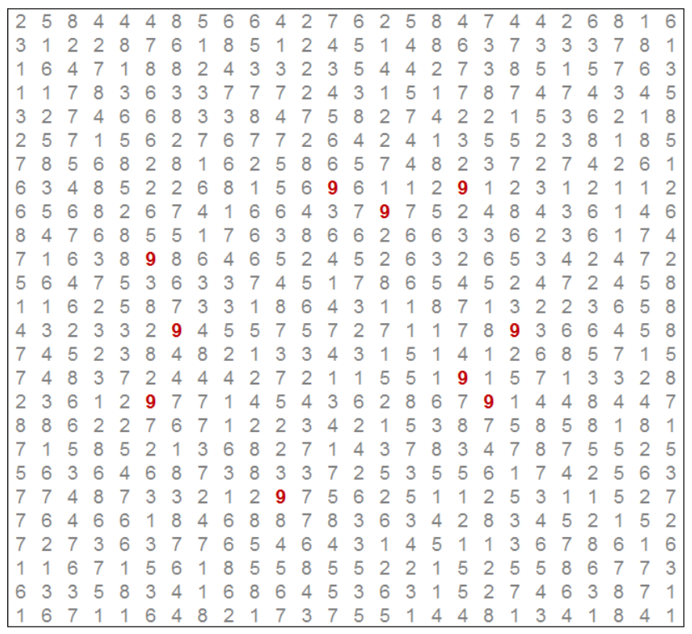
Why Do We Visualize Data?

Slide 30
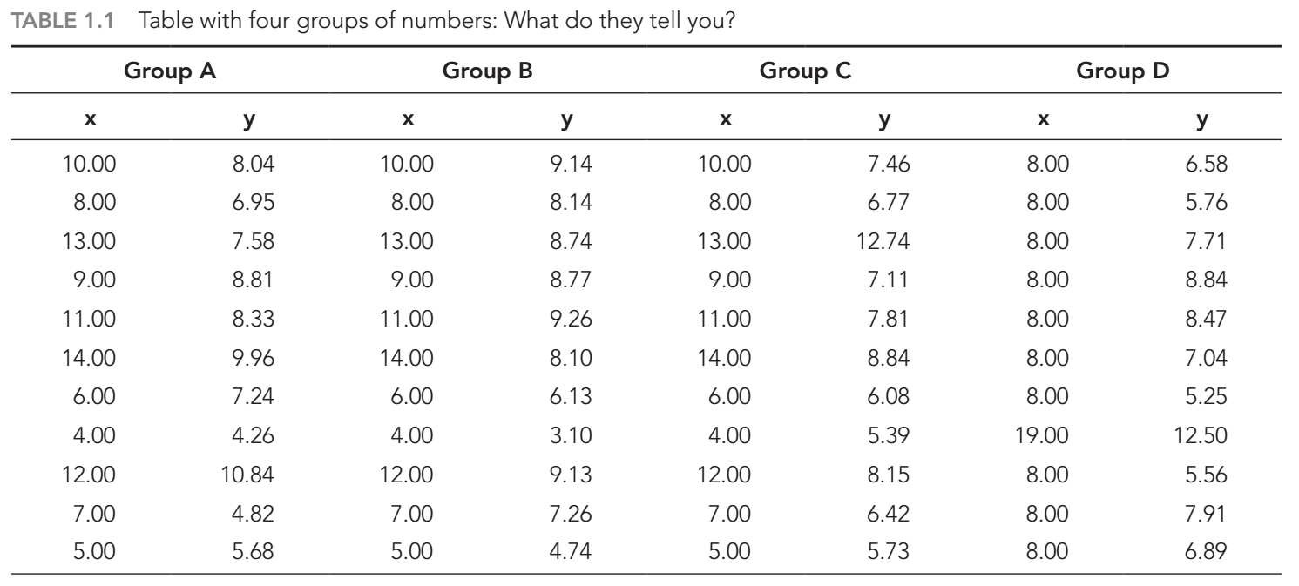
Why Do We Visualize Data?

Slide 31

Explore Data
“Anscombe’s Quartet”—in the paper “Graphs in Statistical Analysis” in 1973.

Slide 32

Discover the trends of data

Slide 33

Neural network Interpretable

Slide 34

Neural network Interpretable

Slide 35


Neural network Interpretable
https://www.youtube.com/watch?v=BR9h47Jtqyw

Slide 36

Decision Boundary
https://scikit-learn.org/stable/auto_examples/classification/plot_classifier_comparison.html

Slide 37

Presenting a hypothesis
10.1016/j.celrep.2021.109722

Slide 38

Summary scientific facts
https://doi.org/10.1038/s41576-021-00438-5

Slide 39

Graphical abstract
10.1016/j.celrep.2021.109722

Slide 40

Rapid in vitro evolution of flucytosine resistance in Candida auris
Notes:
FIG 5 The 5FC tolerance is associated with gene expression profiles.
MIC assays for strains exhibiting 5FC tolerance. Three biological replicates were performed.
Heatmap with hierarchical clustering of comparisons between tolerant and sensitive strains. Circle dots indicate differentially expressed genes (adjusted P-value < 0.05).
(C and D) Gene ontology (GO) enrichment analysis using the enrichGO function from the clusterProfiler R package. Upregulated (C) and downregulated (D) genes between T1 and S1 are shown. Cellular component terms are visualized.

Slide 41
Reference
Data visualization
https://www.youtube.com/watch?v=3X3cjEqaPro&list=PLZo40sVmw_4My97tv62aDITkOxOaJup7X&index=1
https://www.youtube.com/watch?v=Khj94kaJjWo&list=PLg91P4KVeUZbg28jiPq_qTgTCf6xQya-e
(https://sas.uwaterloo.ca/~rwoldfor/courses/DataVisualization/Slides/2020/)
https://curran.github.io/dataviz-course-archive/
Machine learning visualization
https://goodekat.github.io/presentations/2020-isugg-iml/slides.html#1
https://medium.com/analytics-vidhya/awesome-machine-learning-visualizations-5208f1617ec5

Slide 42
Thank you for your listening Q & A

